Slide 1






EXPLORING THE NUTRIENTS IN OUR FOOD
https://www.youtube.com/watch?v=Urr-MKKs8zc

Slide 2

The importance of nutrients
The nutrients in food have 3 roles:
They provide materials for growth and repair.
Energy to keep your cells alive.
Vital elements and compounds to maintain the chemical reactions in your cells.
https://www.youtube.com/watch?v=NqV1Ig4_nfI

Slide 3
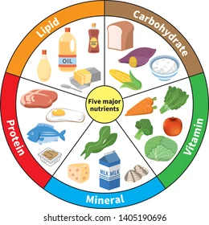
Nutrients in food
Food can generally be classified into the following 7 major groups:
  Carbohydrates
  Proteins
  Fat
  Vitamins
  Minerals
  Fibre
  Water

Slide 4
Nutrients
Food is eaten and digested in the body to allow the absorption of energy and nutrients.
There are two different types of nutrients:
macronutrients
micronutrients
There are three macronutrients that are essential for health:
carbohydrate
protein
fat
There are two types of micronutrients:
vitamins
minerals

Slide 5
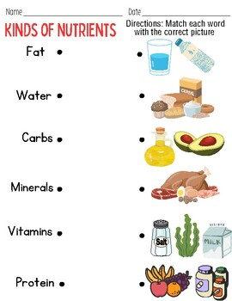
Which nutrient is present in each food?

Slide 6
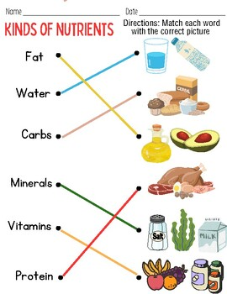
Which nutrient is present in each food?

Slide 7
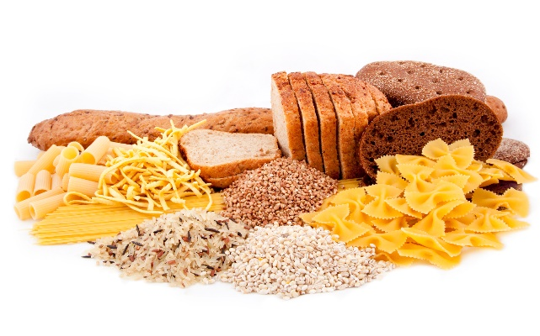
Carbohydrates
(Most of our energy intake should come from this group)
Carbohydrates are large molecules , they are digested in the body into smaller molecules called glucose.
Glucose is a simple sugar that gives the body a quick burst of energy.
The two types of carbohydrate that provide energy are starch and sugars.

Slide 8
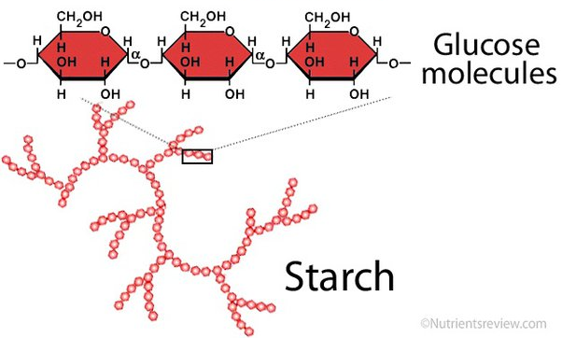
Starchy carbohydrate
Starch is a carbohydrate that is made of lots of glucose molecules joined together.
Starch is found in a variety of foods. Can you give some examples of sources of starch in the diet?
Potatoes
Bananas
Bread
Pasta
Cereals such as wheat and rice

Slide 9
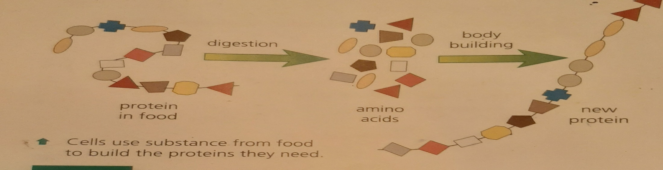
Proteins
Protein is essential for growth, repair and keeping cells healthy. Protein also provides energy.
Proteins are large molecules, they are digested in the body into smaller molecules called amino acids.

Slide 10
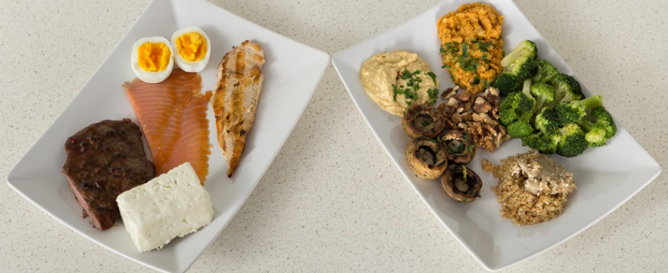
Structure of protein
Proteins are made up of building blocks called amino acids.
Different foods contain different amounts and different combinations of amino acids.
Protein from animal sources (e.g. meat, fish, eggs and dairy products) contains the full range of essential amino acids needed by the body.
Protein from plant sources (e.g. pulses; beans, nuts and cereals) typically contain fewer essential amino acids.

Slide 11
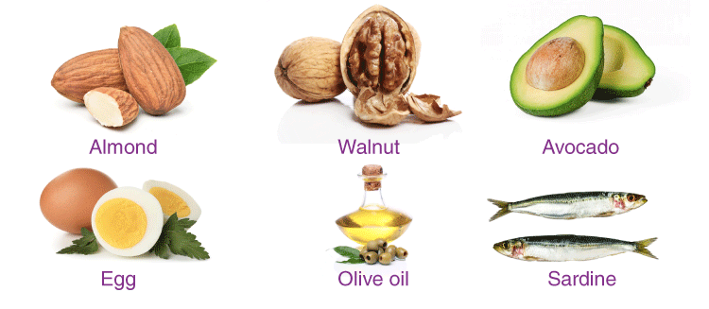
Fats
Fats are important as they make cell membranes, protect vital organs, stored source of energy, reduce heat loss from your skin.
Foods that contain a lot of fat provide a lot of energy.

Slide 12
Fats
Fats :
There are two main types of fat :
Saturated : processed food are often high in it (Found in meat, cheese, butter, hot dogs, chips, cookies).
( they increase the risk of heart disease )
Unsaturated : found in fish, nuts ,vegetable oil.
( these are better for your health )

Slide 13
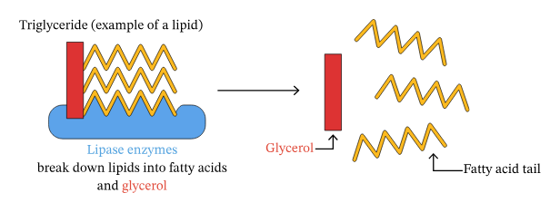
Structure of fat
Fats are large molecules , they are digested into smaller molecules called fatty acids and glycerol which can then be absorbed into the blood.

Slide 14
Question:
Proteins, fats and starch are large molecules made by joining smaller molecules together.
Complete the table to show what is different about each of these small molecules.
Nutrient | Small molecules joined to make them
Starch
Proteins
Fats
Glucose
Amino acids
Fatty acids + glycerol

Slide 15
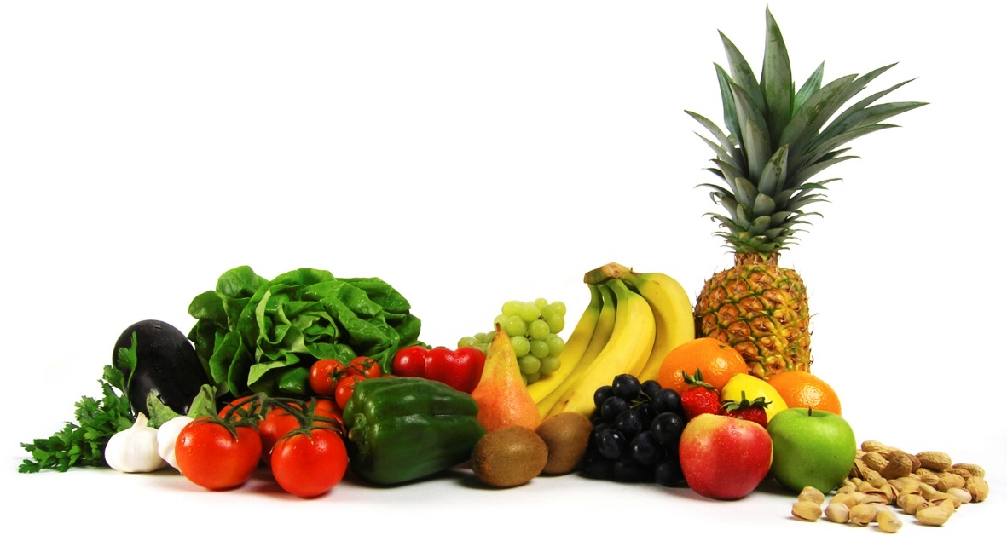
Vitamins
(Help chemical reactions take place in your cells)
There are two groups of vitamins:
• Fat-soluble vitamins, which are found in fish and dairy products can be stored in the body, e.g. vitamins A and D.
• Water-soluble vitamins, which are found in fruits and vegetables cannot be stored in the body and are therefore required daily, e.g. B vitamins and vitamin C.

Slide 16
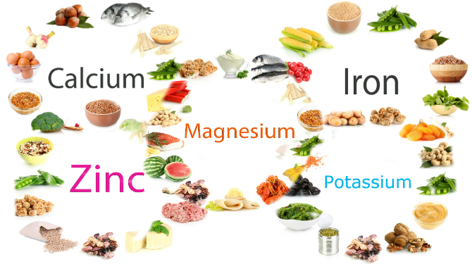
Minerals
(Help cells function properly and strengthen bones and teeth)
Minerals are required by the body in small amounts for a variety of different functions. The body requires different amounts of each mineral.
People have different requirements, according to their Age, gender, physiological state (e.g. pregnancy).

Slide 17
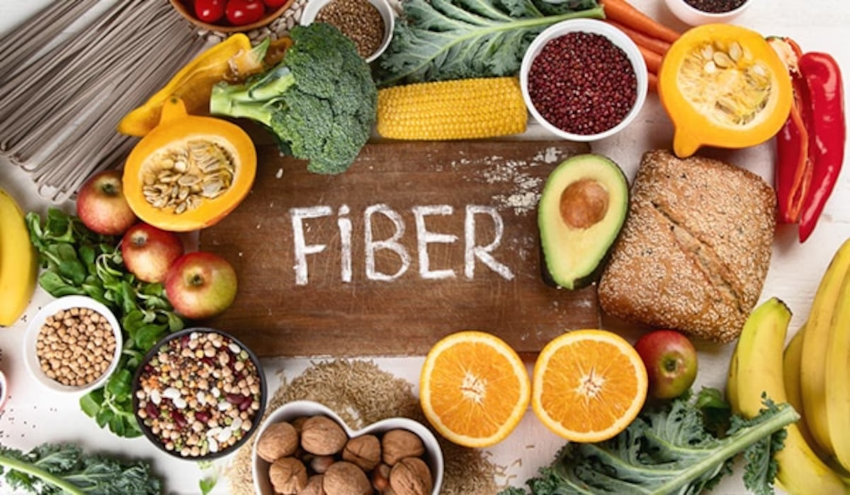
Fibre
Fibre is an important part of our healthy diet, but it isn’t a nutrient.
Fibre is made of large molecules your body can’t digest.
The fibre in food helps it to pass through your digestive system quickly, so it prevents constipation.

Slide 18
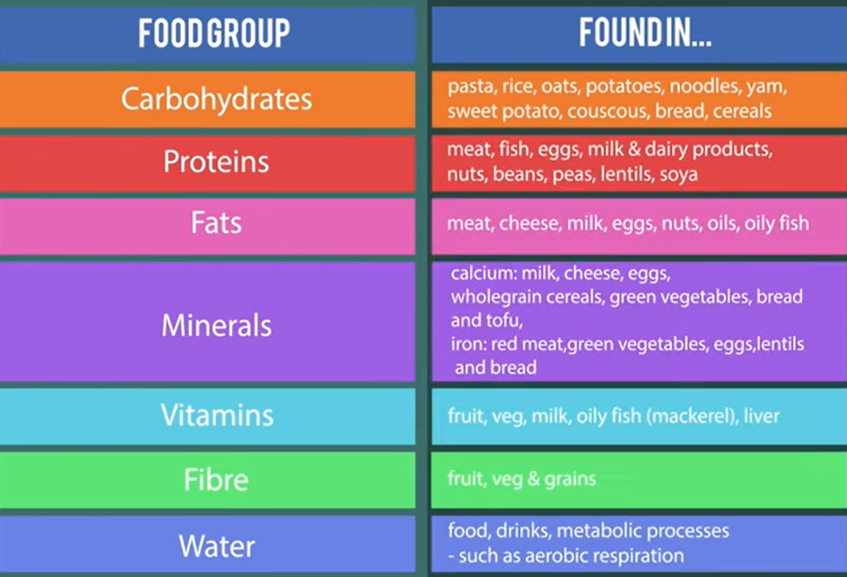

Slide 19
How do we store energy?
Human beings and other animals have two ways of storing energy:
Glycogen is a short-term carbohydrate energy store in our muscles and liver. Glycogen is used in the body to give instant energy if the level of sugar in your blood gets low.
Fat is a long-term way of storing energy in the body.
If we eat more than we need, some of the excess food molecules are converted into fat and stored in special fat cells under the skin and around the organs.
If we do not get enough food, our body breaks down our fat stores to give the cells the energy they need.

Slide 20
Question
Look at the following statements and use them to complete the table comparing the human storage molecules glycogen and fat.
a short-term carbohydrate energy store.
broken down for energy over time if not enough food is eaten.
stored in special cells under the skin and around the body organs.
a long-term energy store.
used for quick, instant energy.
stored in our muscles and liver.
Glycogen | Fat
A, E, F
B, C, D

Slide 21
Kahoot Quiz
https://create.kahoot.it/details/617379f9-cae3-4fc5-bfd6-1e5a7297c9b7
https://www.liveworksheets.com/lr1661485rv
Live worksheet

